Slide 1
Python Conditions

Slide 2
Equals: a == b
Not Equals: a != b
Less than: a < b
Less than or equal to: a <= b
Greater than: a > b
Greater than or equal to: a >= b

Slide 3

Example
a = 33
b = 200
if b > a:
print("b is greater than a")

Slide 4
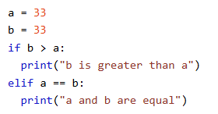
Elif
The elif keyword is Python's way of saying "if the previous conditions were not true, then try this condition"

Slide 5
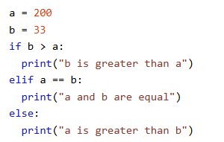
Else
The else keyword catches anything which isn't caught by the preceding conditions.

Slide 6
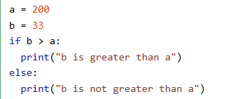
Example

Slide 7
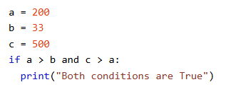
And
The and keyword is a logical operator, and is used to combine conditional statements:

Slide 8
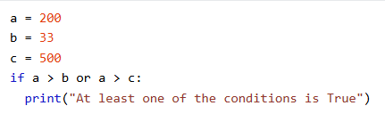
Or
The or keyword is a logical operator, and is used to combine conditional statements:

Slide 9

Not
The not keyword is a logical operator, and is used to reverse the result of the conditional statement:

Slide 10
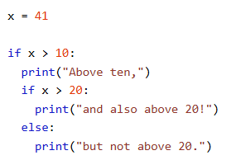
Nested If
You can have if statements inside if statements, this is called nested if statements.

